Slide 1
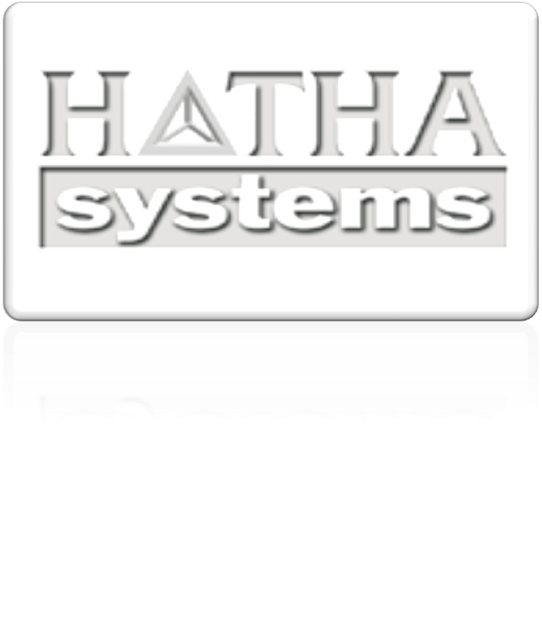
®
Extracting system knowledge to manage risk.
Notes:
Welcome and thank you for the opportunity present our company.
To help understand Hatha’s value I would like you to imagine that you just bought a 100 year old house that you want to modernize the kitchen and add a new master bedroom and bath. You’ve got a drop dead date to move out of your old house. There’s no original blueprints and very little historical knowledge about the house. The contractor and architect do their best based on what they know to cost the project and put a timeline together that comfortably fits the deadline. Then walls are cracked open and all hell breaks loose. You are the proud owner of lead pipes, and asbestos. That load bearing wall has old termite damage and some hack electrician made a mess of the wiring 20 years ago. Costs just tripled, the timeline is out the window and you are scrambling to find temporary housing before schools start. Now imagine what that project would have been like if you had had a complete set of blue prints that showed precisely the current state of that house. Every modification, alteration, fumigation, roof patch…everything that exists in that house today from the day if was built until this very moment. Imagine how precise and effective the contractor and architect could be with that sort of knowledge. Imagine how more effective your decisions would be. Your risk posture would go from out of your control to being closely managed and your chance of a successful happy ending would increase dramatically. In the world of IT systems – Hatha provides that kind of blueprint and knowledge.

Slide 2
Company Overview
Extracting system knowledge to manage risk.
  Common Analysis Platform Environment for software that delivers results more accurately, faster, and at a much lower cost – up to 80-90% lower depending on the environment and project.
  Risk Reduction: faster more knowledgeable decision points, transparency throughout process, lower total cost of ownership
Focused on Government, Financial, HealthCare
  Software Modernization
  SOA and Cloud Enablement
  Software Compliance and Security
Executive team – over 10 decades leadership experience in modernization, software security & assurance, and code analysis
Established in late 2006
9/13/2010
© Hatha Systems®, LLC

Slide 3

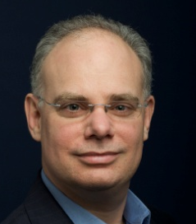
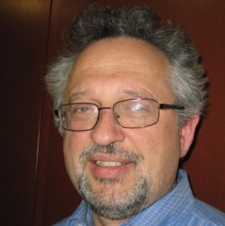
Experienced Executive Team
Rama Moorthy, CEO and Founder
  Booz Allen Hamilton, Sun, Network Associates, Siemens, AMD
Marty Fletcher, COO
  Third Brigade (Co-founder), Entrust, DEC/Compaq, Conner Peripherals, US Air Force, …
Mike Oara, CTO
  Relativity Technologies (Co-founder), Seer Technologies, Software AG, First Boston, Morgan Stanley, Avon Products, Chase Manhattan
© Hatha Systems®, LLC
Notes:
Rama Moorthy, CEO and Founder
20-years of experience running both product and services organizations (AMD, Siemens, Network Associates, Sun, Booz Allen Hamilton)
Expertise in security and assurance, product marketing/management, sales, business development, new market/product-line development
Heavily integrated into the DoD organization establishing access to key contacts within the U.S. Government
Marty Fletcher, COO
25-years of experience in sales, marketing, business and market development, product marketing/management , and executive leadership (Entrust, DEC/Compaq, Conner Peripherals, US Air Force, …)
Co-founder and VP of Business Development of Third Brigade - acquired by Trend Micro, a relationship he established and nurtured
Mike Oara, CTO
Decades of experience and industry leader in modernization (Chase Manhattan, Avon Products, Morgan Stanley, First Boston, Software AG, Seer Technologies, Relativity Technologies)
CTO and architect of Relativity modernization tools
Domain strengths in banking and legacy COBOL & C code and UML expertise
Chris Caputo, Chief Modernization Architect
15-years of modernization service delivery capability (Blue Phoenix, Ateb Inc., Iditarod Systems)
Core developer of the FOSE award winning prototype
KDM specification expertise, and healthcare domain expertise
Management and Technical Team Experience
Decades of leadership experience in:
Organization and program management
Directing software development programs
100+ years of hands-on development experience
Architecture/modeling
System modernization
IT Security, Software Assurance, and Compliance
Systems Engineering Process (SSE/CCM, CMMi, Quality Management/Assurance)
IT, IA, Information management programs at various government organizations
15+ years in DIACAP/DITSCAP FISMA compliance leadership, consulting and training
Clearance levels include DOD Top Secret (TS)
Industry Involvement
Knowledge Discovery Meta-model (KDM) - Object Management Group (OMG)
Department of Homeland Security Software Assurance Community
Board of Directors W2COG (GIGlite) Organization
IT Sector Coordinating Council (CIPAC/ITSCC)

Slide 4







Knowledge Refinery®
Hatha Knowledge Refinery™
Maintenance
Modernization
Security
Compliance
Continual Compliance
Extraction
Storage
Analysis
System Knowledge
Customer Software System
© Hatha Systems®, LLC
Notes:
We have created the concept of a knowledge refinery to describe what we are doing. The Hatha Knowledge Refinery is a software product that acts much like an oil refinery might. In our case the oil or raw materials is the customer’s custom software. We extract all the information about the system including the actual code, the architecture, system flows and controls, the data flows, the business rules, and a whole lot of data about this data or metadata. All of this information is stored in a repository that can be accessed, analyzed, and sliced and diced in multiple ways to quickly get the knowledge necessary make informed decisions, and perform effective tasks relating to the systems and processes. Today our product provides immediate value to modernization and maintenance efforts and we are finding our way into helping with software security issues as well. Longer term we see compliance and even real-time or continuous compliance applications for the product.

Slide 5
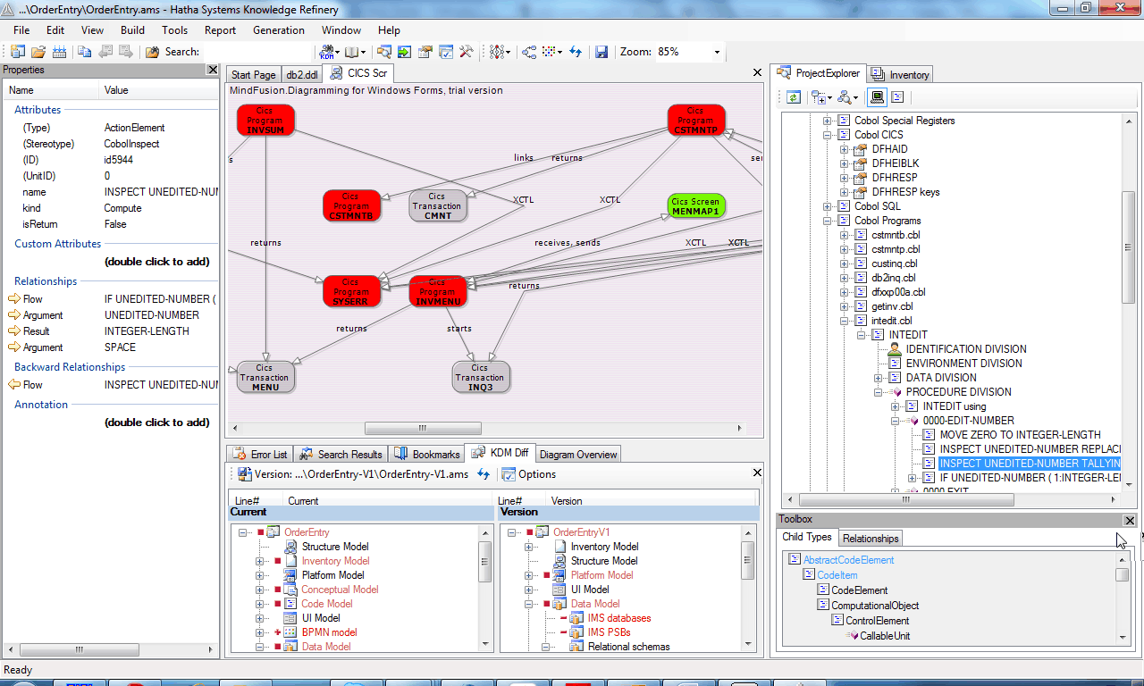
Knowledge Refinery®
Discovery and Extraction
Meta Data Repository
Abstraction, Refinement and Analysis
Common Analysis Platform Environment (CAPE)
Modular Architecture
“snap in” support
COBOL , C, Java, C++ , others
International Standards
ISO, OMG, W3C
KDM, BPMN, SBVR, UML, RDF, …
Powerful Transparency Tool with Multiple Applications
Business Driven Modernization
SOA and Cloud Enablement
Compliance/Security Assessments
9/13/2010
© Hatha Systems®, LLC

Slide 6



















Knowledge Refinery Platform
Integrated Analysis Environment (IAE)
Software System Static Analysis Platform(s)
Extraction of Data Flows| Control Flows| Architecture| Business Rules|
Code/Architecture/Process Weaknesses| Business Processes| System Compliance|
KDM based platform – Querying environment (kPath or SparQL)
Storage Standard (XMI, RDMS, RDF)
Legend
Functional
Simulation
(Future)
Standards based Analysis Platform
Business Process
Simulation
(BPMN)
Standards based analyses and migration solutions
Software Systems & Applications
(COTS, GOTS, Custom)
Compliance
(kPath/SBVR)
(FISMA, CC, FIPS
HIPPA, SOX)
(SBVR/kPath)
Rules extraction for
Analysis or
Rules engine use
(RIF)
Generation
(Code, D/B schema,
WSDL, Service
Definitions)
(KDM/UML)
System
Documentation
(KDM)
Security Analysis:
Weakness &
Criticality
(KDM/kPath)
Simulation
(BPMN/KDM)
Extraction
Automated Analysis
Parsing
Legacy Applications (COBOL/CICS/JCL/IMS/DB2/PL1/VB6, etc)
COBOL/C
Program
Java Application
Java/C++
Program
C
Program
C#/VB
Program
…
Others (MUMPS, Fortran, etc)
© Hatha Systems®, LLC

Slide 7

Enterprise Software Systems Static Analysis Standards Mapping
Business Transaction Process Modeling/Simulation
(BPMN Standard)
Formal Representation of Semantic Controls
(FISMA, CC, FIPs, CWE, HIPAA etc)
(SBVR Standard)
Extraction of Configuration Data (including black box interface data)
(KDM Standard)
Inputs (BPMN & SBVR) into Analysis Environment (KDM) for gaps and compliance analysis
Automated Extraction of System Architecture
(KDM Standard)
Enterprise System
Static Analysis
(Modernization, System Integration, Security, Compliance, Assurance)
Common Repository/
Common Data Format
kPATH* or Sparql Querying
Data Store using XMI, RDF, RDBMS; Analytics/Correlation
Extraction of system Data Flows and Control Flows (KDM Standard)
kPath* or SparQL querying languages;
kPath usable for rules enforcement for gaps analysis and compliance;
Automated Extraction of Code Weaknesses
Within System
(KDM Standard, etc)
Automated Extraction of Business Processes
(BPMN Standard)
Automated Extraction of Business Rules
(KDM Standard)
Business Rules Analysis
(RIF Standard)
Legend:
KDM: Knowledge Discovery Metamodel ISO standard
RDF: Resource Description Framework – W3C standard
BPMN: Business Process Modeling Notation – OMG standard
SBVR: Semantics of Business Vocabulary and Rules - ISO standard
Note: kPath* Querying Language to be released to OMG for standardizing in 2011; not a standard today
© Hatha Systems®, LLC,

Slide 8

®
Thank You
Rama S. Moorthy
rama.moorthy@hathasystems.com

Slide 9
Software Transformation Approaches
Transformation Project With Automated Legacy Knowledge Extraction, and Code Generation
  Automation used where possible through out process
  Quality high – each step properly executed with speed and accuracy
  Lower time and resource and lower quality risks
Automated Legacy Code Analysis and Knowledge Extraction
Req’ment Definitions
New Code Generation and Development
Test , Adjust and Deploy
Transformation Project With Automated Code Generation
  Automated code generation with limited to no legacy analysis or requirement definition work
  Quality varies - Quick jump to new environment requires extensive adjustments and testing
  Lower time and resource risk but introduces quality risks
New Code Generation and Development
Test , Adjust and Deploy
Transformation Project With Limited to No Automation
  Manual methods with limited automation
  Quality high – each step properly executed
  Lower quality risk but higher time and resource risk
Legacy Code Analysis and Knowledge Extraction
Requirement Definitions
New Code Development
Test , Adjust and Deploy
© Hatha Systems™, LLC

Slide 10
It’s About Time and Money
Examples of Direct Activity Productivity Gains Over Current Methods
Activity | Cost reduction
Understanding | 60-80%
Documentation | 70-90%
Business concepts extraction (terms and rules) | 50-80%
Code clean-up (dead code, obsolete code, obsolete data) | 70-90%
Database migration (creating the design of the target database) | 50-80%
Code migration | 10-50%
Based on our experience in performing and managing modernization projects
Impact on activities and total project will very based on specific circumstance
© Hatha Systems™, LLC

